Slide 1
Little Center Inventory System
Software engineering project
Course: CSCI 250 (Spring 2019)
Professor: John Magee
Team members:
Alexander Rakovshik, Ishraq Salim Chowdhury, and Skyler Brivic

Slide 2
Client:
Kevin McGerigle
Technical Director & Theater Designer at Clark University
What problem does it solve?
People have been borrowing equipment (lights, speakers etc.) for events without formally signing the equipment out, making it unclear as to who has a given product and whether or not a missing product is truly missing, or is simply being used for an event.
Requirements:
An app/software/website that allows keeping track of inventory in the theater department
Print a label/assign a number to each lighting and sound equipment
Allow client to view online who has what item, when they took it, and when they brought it back.

Slide 3
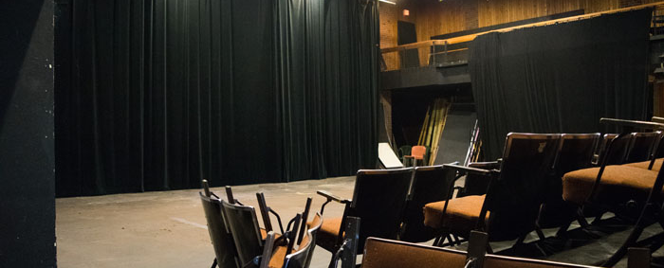
And the show begins…

Slide 4

Project deliverables:
An online database:
currently holds 75 items.
keeps track of who borrows item, contact information of borrower, what item borrowed, check-out time, check-in time, etc.
Quick Response (QR) codes for each item.

Slide 5
Backend details
Can include screenshots

Slide 6
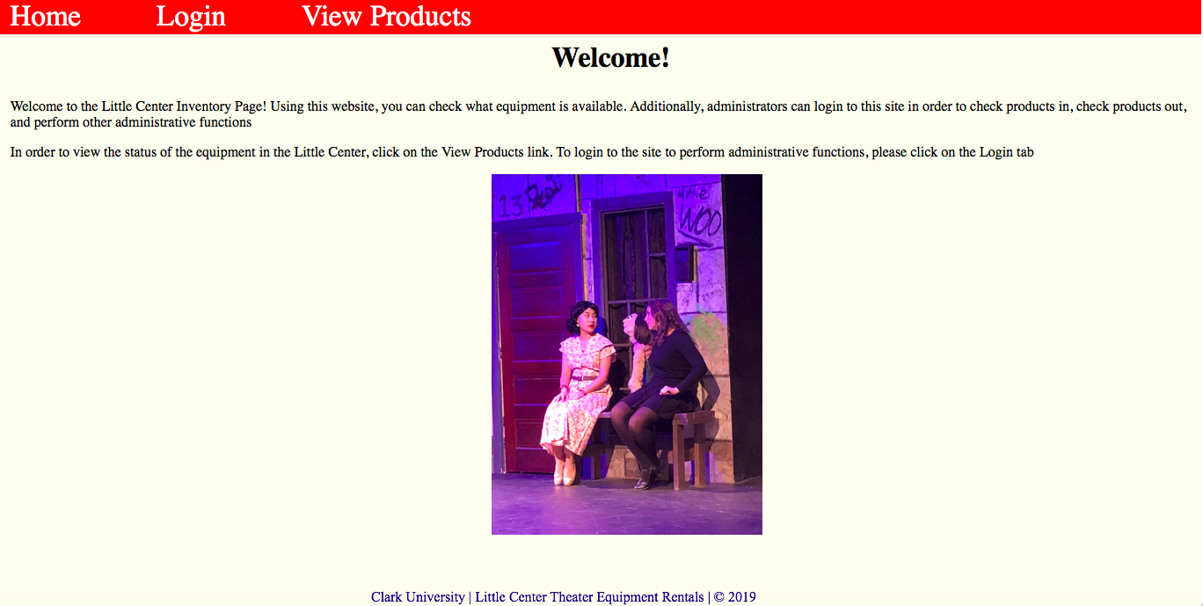
Frontend:

Slide 7
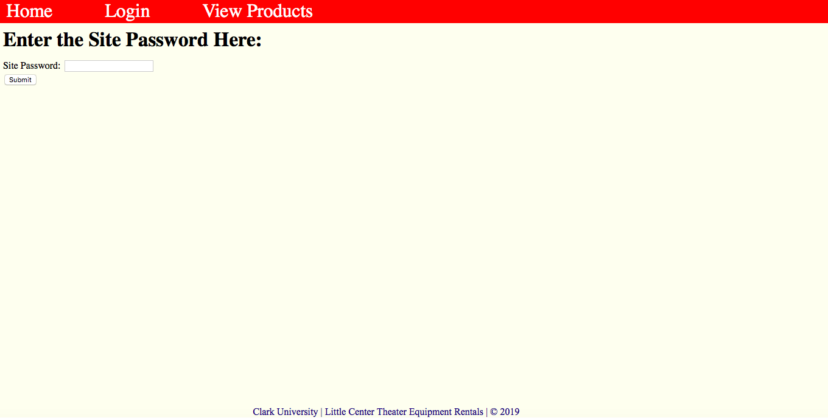
Frontend (continued):

Slide 8
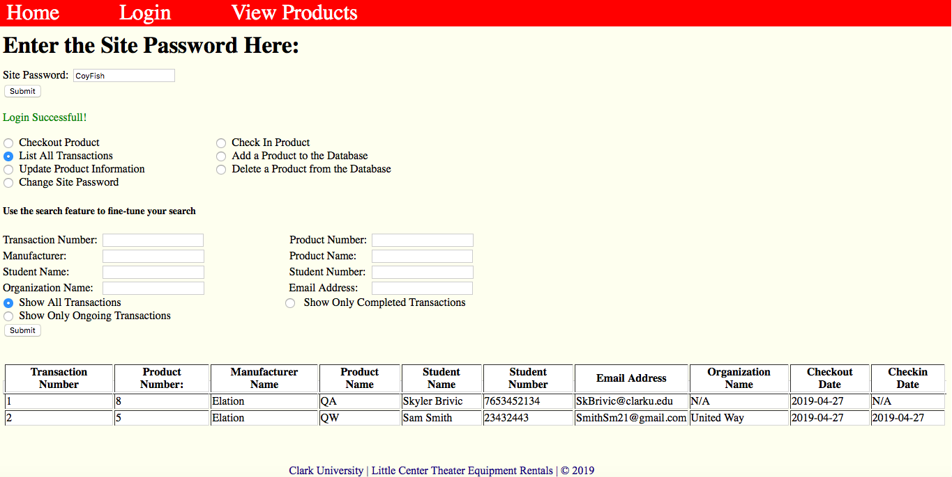
Frontend (continued):

Slide 9
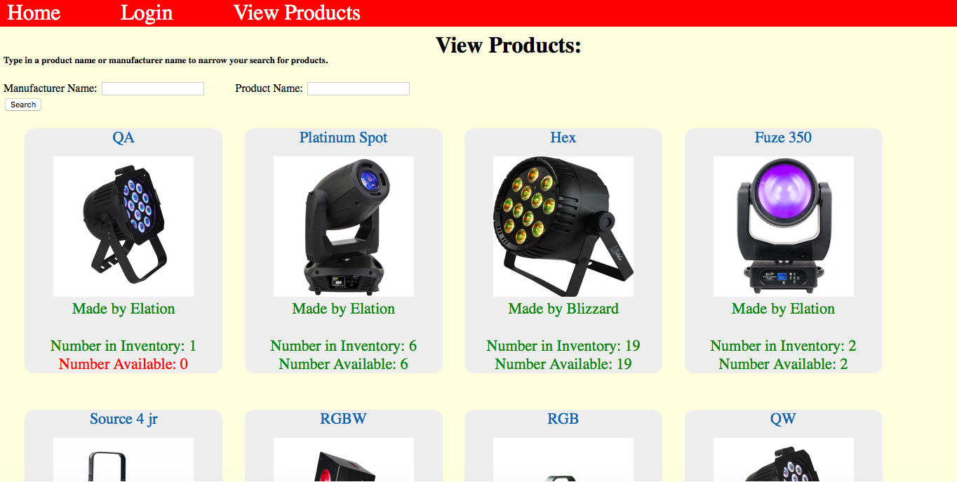
Frontend (continued):

Slide 10
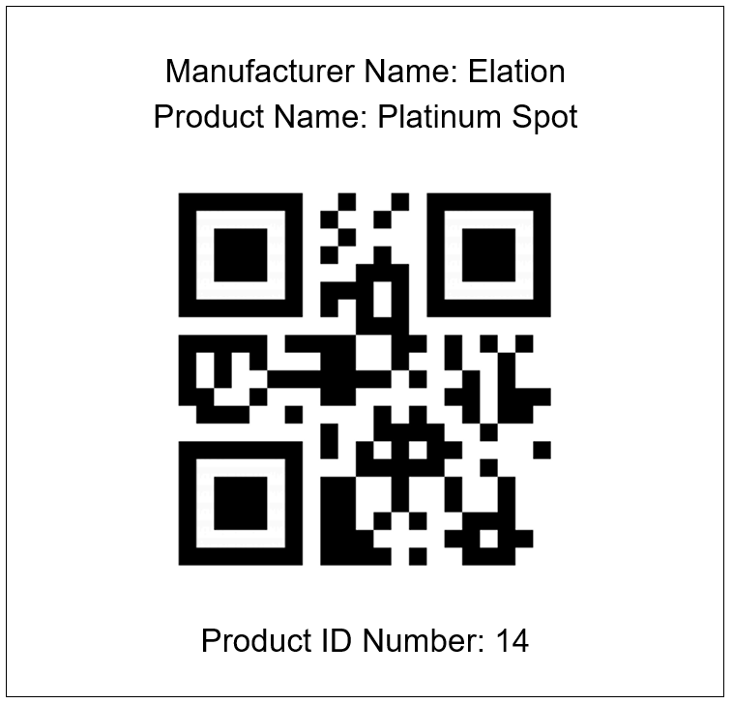
QR codes:
Purpose:
Scanning QR codes give the product ID number which can be inputted into the system.
Future goal:
Scanning QR code will lead directly to the database URL, once server is set up.

Slide 11
Talk about waterfall process (inception, planning, requirement analysis, etc.)
Can add screenshots of github, trello, slack to show communication side.
Can include email exchange with Kevin
Basically how we implemented stuff taught in class

Slide 12


Slide 13
THANK YOU
Have a great summer break!

Slide 14
Team dynamics:

